Slide 1
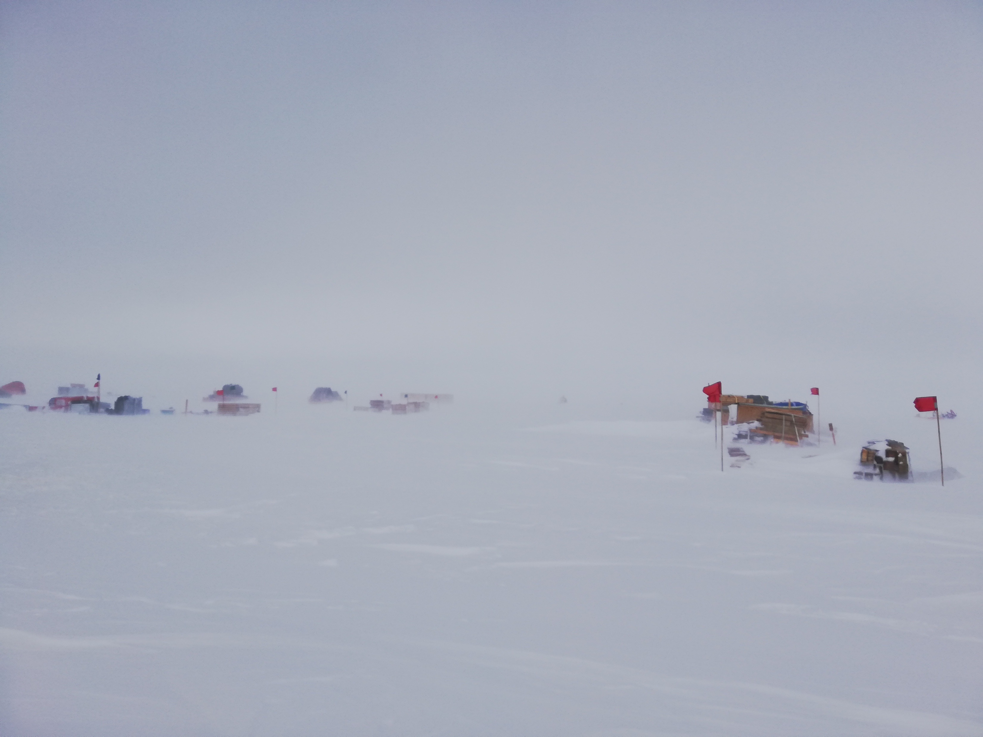
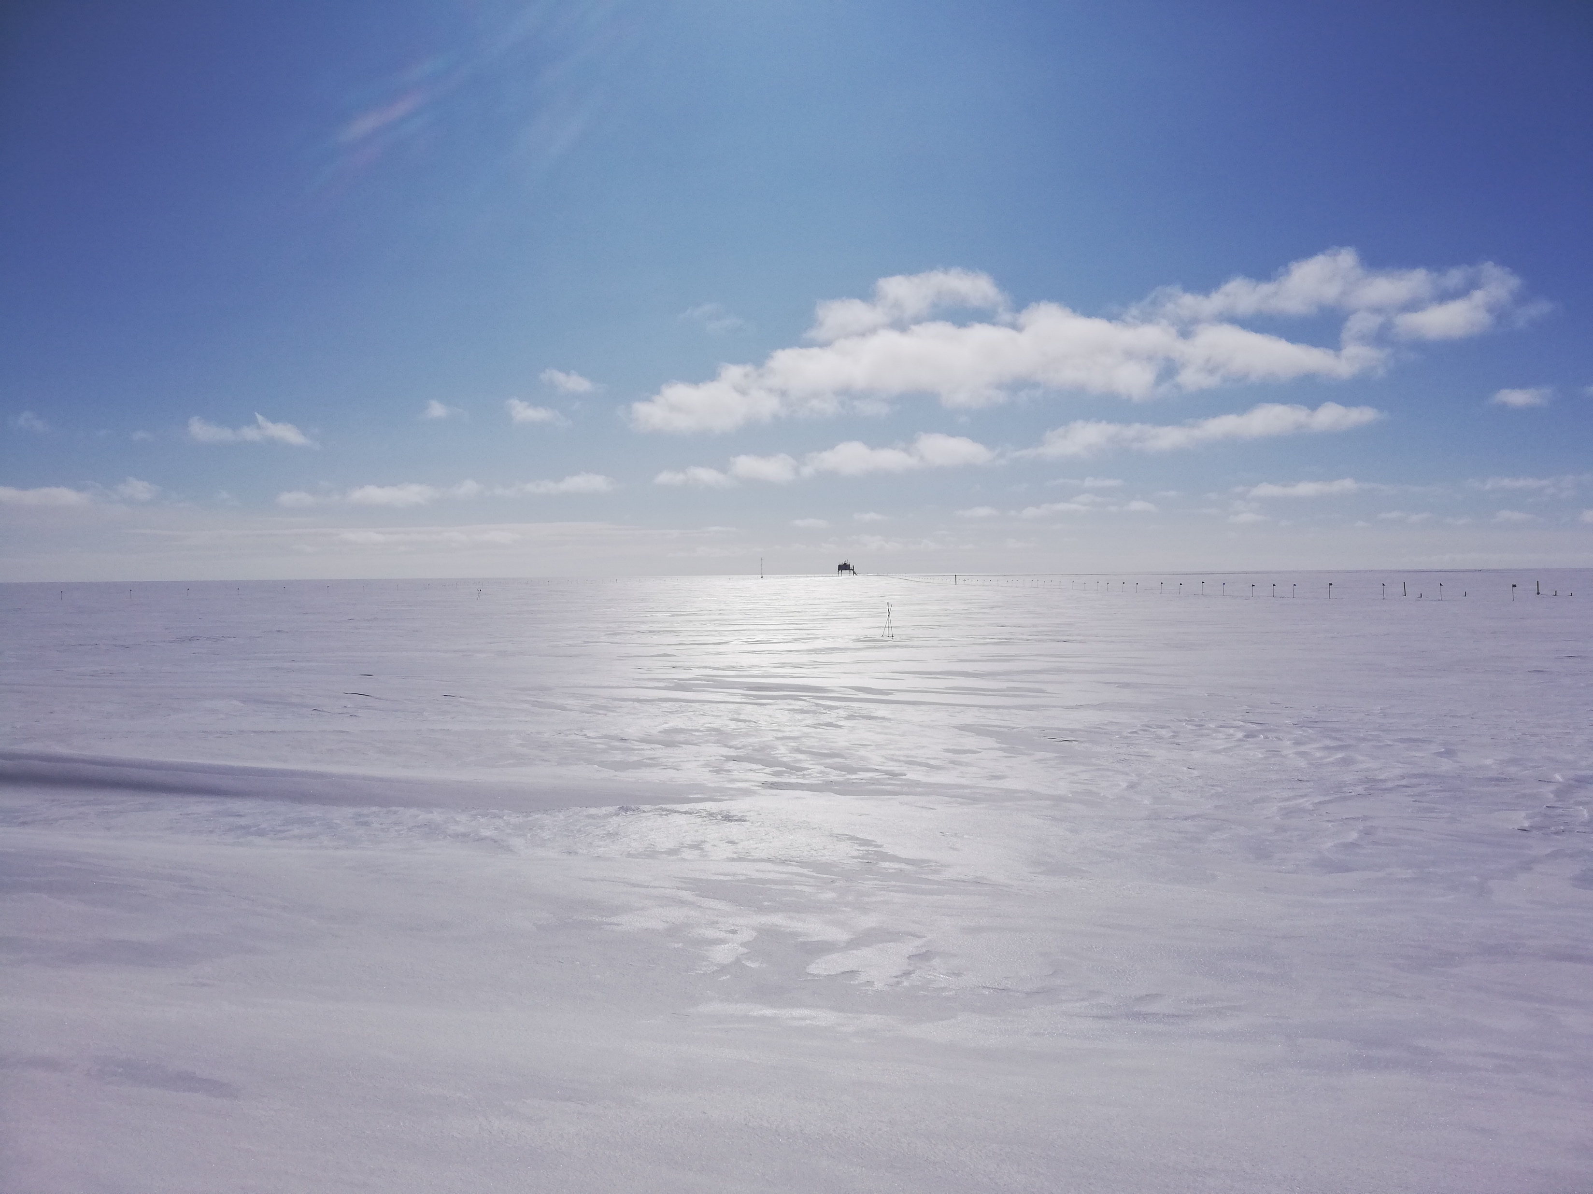
Photo: 29-July-2019
The July 29th melt event was characterized by extensive cloud cover, low visibility, high winds and blowing snow.
Photo: 31-July-2019
When the low visibility associated with the melt event cleared up, the snow surface was visibly altered to a smooth reflective layer.

Slide 2
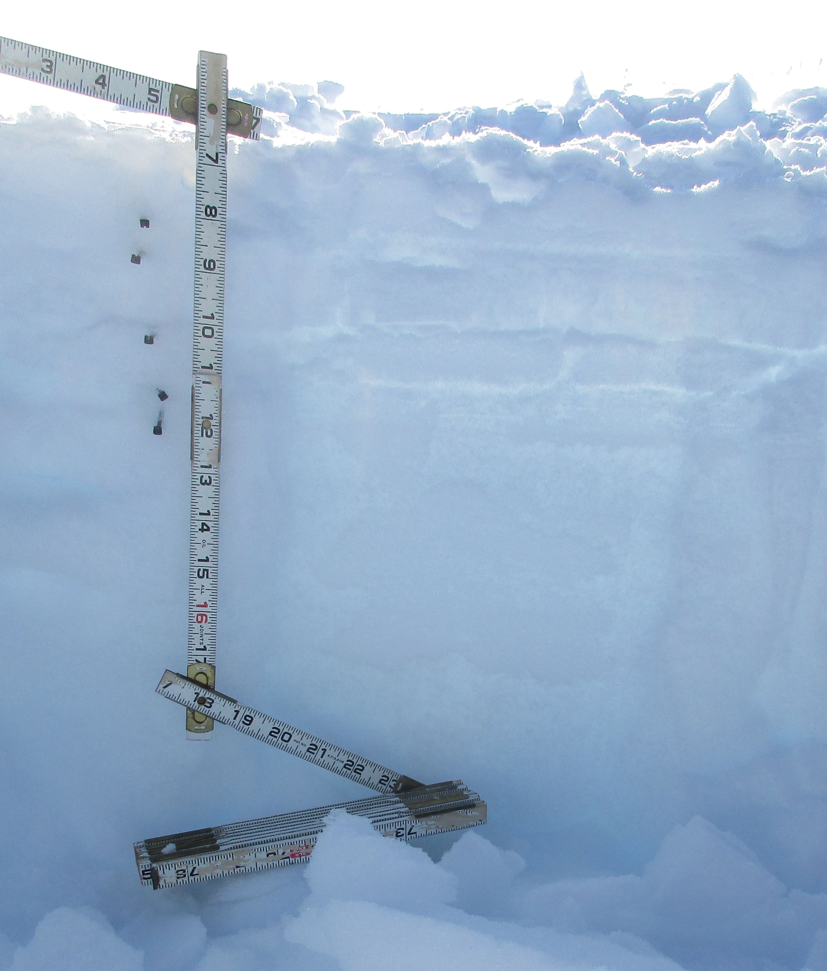
Shallow snow pit, 2019-09-19 1230Z, in undisturbed area just south of the MSF.
Estimated accumulation since 2019-07-29 is approximately 8cm (~3 inches)
Snow pit depth ~ 50 cm.
Below around 22cm depth the snow becomes more uniform and layers are difficult to identify, I focused on the top 22 cm.
The top layer of soft snow covers a dense layer that feels like wind slab, between 1.5-3.5 inches. This slab is uniform in space and according to the accumulation estimation, would have formed around the time of the melt event.

Slide 3
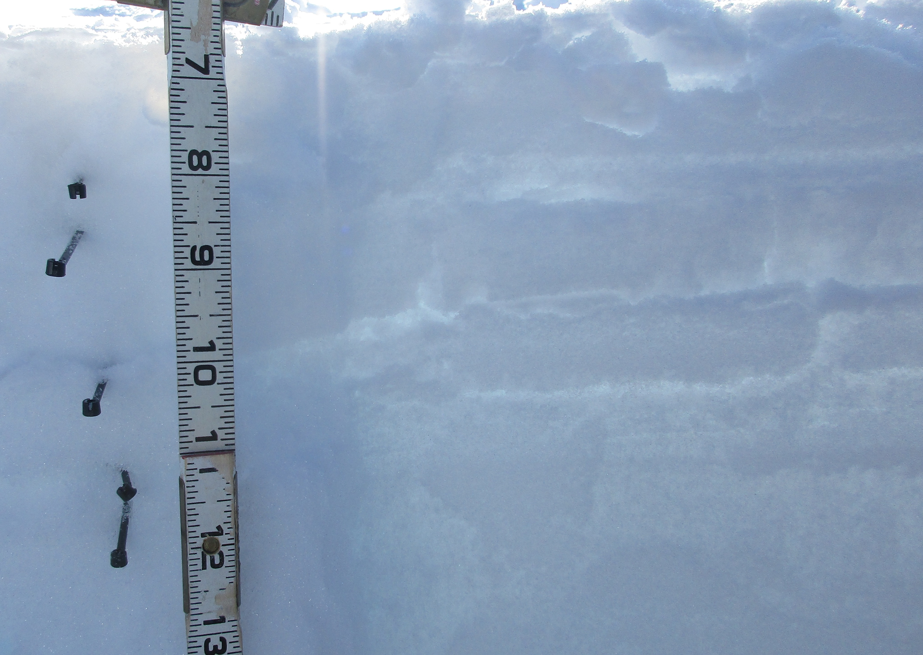
Layers identified:
0 – 1.5 inches
1.5 – 2 inches
2 – 3.5 inches
3.5 – 4.5 inches
4.5 – 5.5 inches
5.5 – 8.5 inches
1)
2)
3)
4)
Layer | Description | Hand hardness | Density (kg/m3)
1 | Soft surface snow | Fist | 140
2 | Dense icy layer | Pencil | 340
3 | Dense and icy slab. slightly softer than 2. | Pencil (easier than above) | 220
4 | Sugary | 4 finger | 120
5 | Sugary | 4 finger | 67
6 | Uniform compacted sugar. | 2 finger | 260
5)
6)

Slide 4
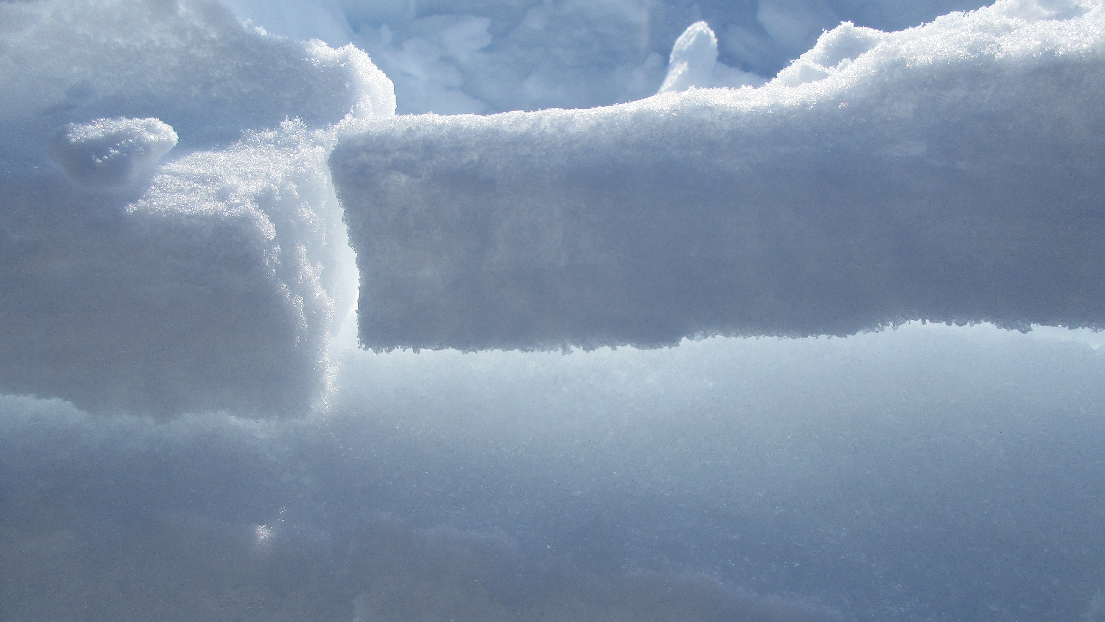
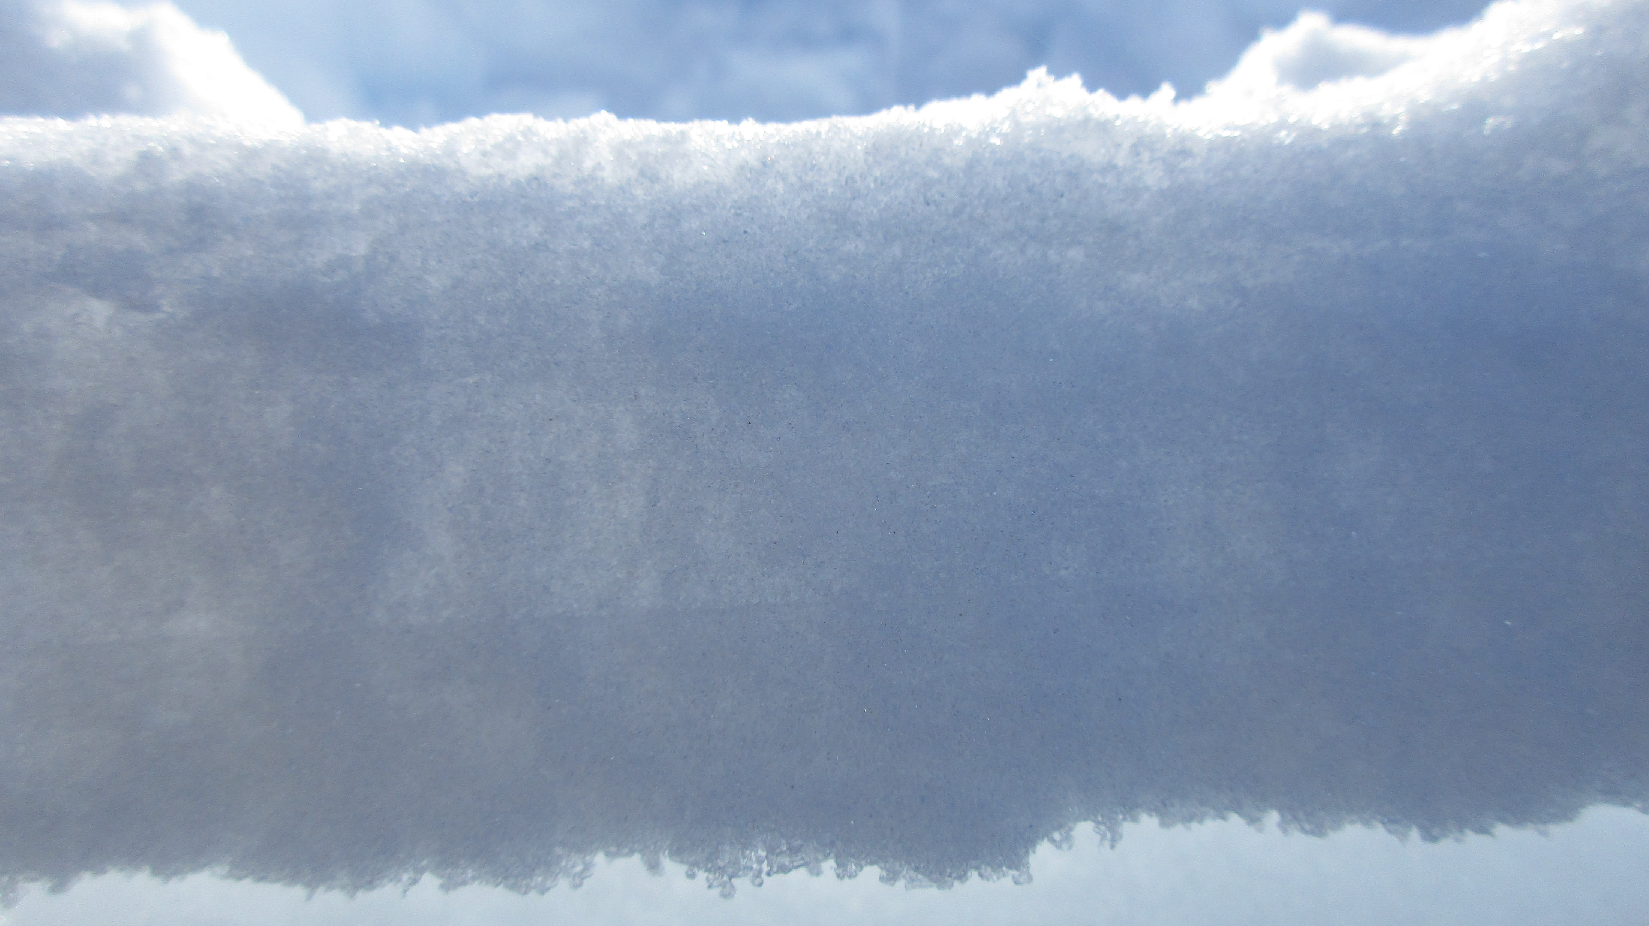
Some photos of the dense slab layer between 1.5 and 3.5 inches. It is possible to identify different layers within the slab.

